Slide 1
Intellaturbine
Sponsor/mentor: Shaun Dunbar
Group 9
Dwayne Smith
Joaquim Thompson
Jose Dominguez
Timothy Knob

Slide 2
Motivation
Functional wind generation system
  Capable of removing average house holds from the power grid
Maximum Power Point Tracking (MPPT) Charge Controller
Data logging and display capabilities
  Monitoring performance
  Testing
  Maintenance

Slide 3
Goals
User friendly
  Display
  Data logging
  Self sufficient
High efficiency power generation
  MPPT
Capable of supporting different voltage battery banks
  12 & 24 Volts

Slide 4
Specifications
500 Watt System
12 & 24 Volt battery bank
  Capable of at least 400Ah
Approximately 90% efficient
Change in design due to availability of turbine

Slide 5

Design Overview
Rectifiers
Power
Diversion
Charge
Controller
Microcontroller
(MPPT, PWM)
Battery
Bank
LCD Display
Microcontroller (Data Logging)
Sensors
SD Card Output

Slide 6
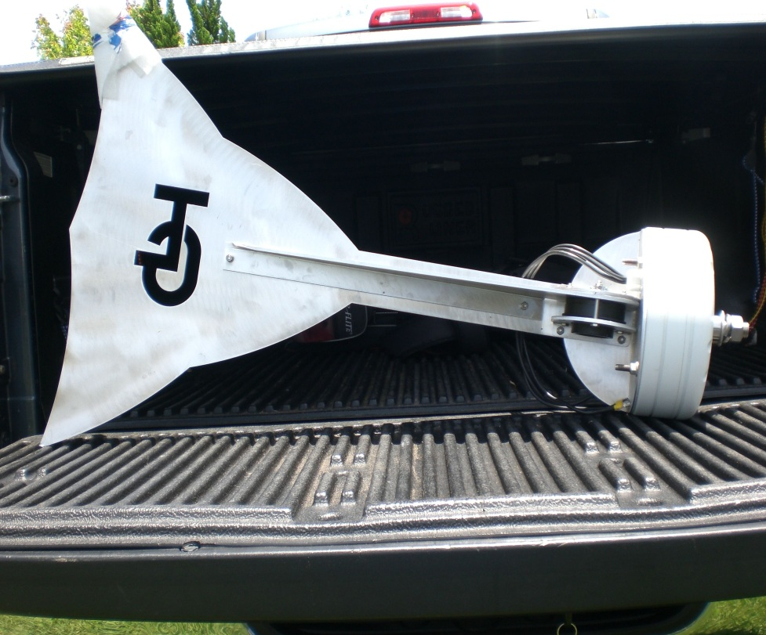
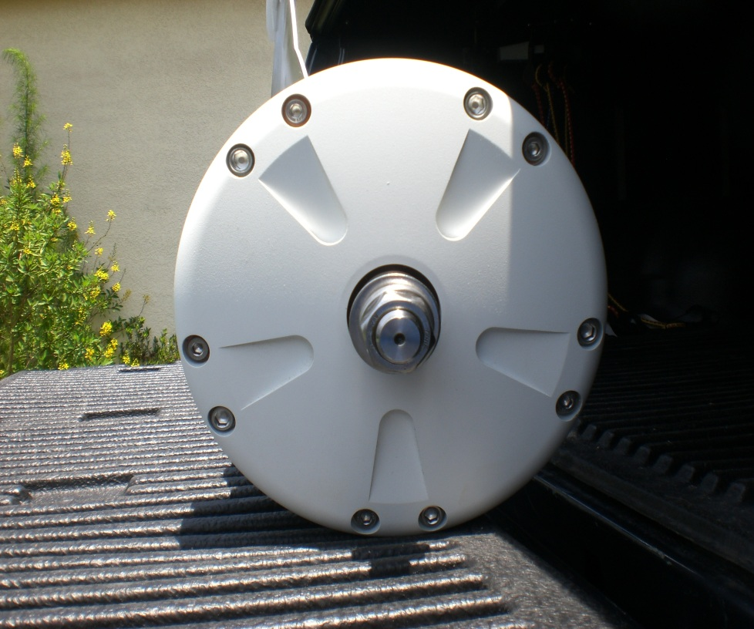
Wind Turbine
Length: 3’ 6”, Width: 2’ 4”, Diameter: 11”
Weight: 68lbs

Slide 7
Wind Generator
TLG 500 Alternator
  Rated at 500 watts
Wind Speed MPH +/- 2 | Amps into Battery Bank +/- 0.5 | Battery Voltage +/- 1 | Average Watts
7 MPH | 1 Amp | 24.0 Volts | 24 Watts
9 MPH | 2 Amp | 24.0 Volts | 48 Watts
15 MPH | 5 Amp | 24.8 Volts | 124 Watts
20 MPH | 10 Amps | 25.2 Volts | 254 Watts
25 MPH | 15 Amps | 26.8 Volts | 402 Watts
34 MPH | 23 Amps | 27.1 Volts | 623 Watts
40 MPH | 30 Amps | 28.2 Volts | 846 Watts
45 MPH | 39 Amps | 28.5 Volts | 1111 Watts
50 MPH | 50 Amps | 29.8 Volts | 1490 Watts

Slide 8
Charge Controller
3 Phase Rectifier
Buck Converter
Battery Bank
Interface Circuits
MOSFET Driver
MCU
Dummy Load
PWM
ON/OFF

Slide 9
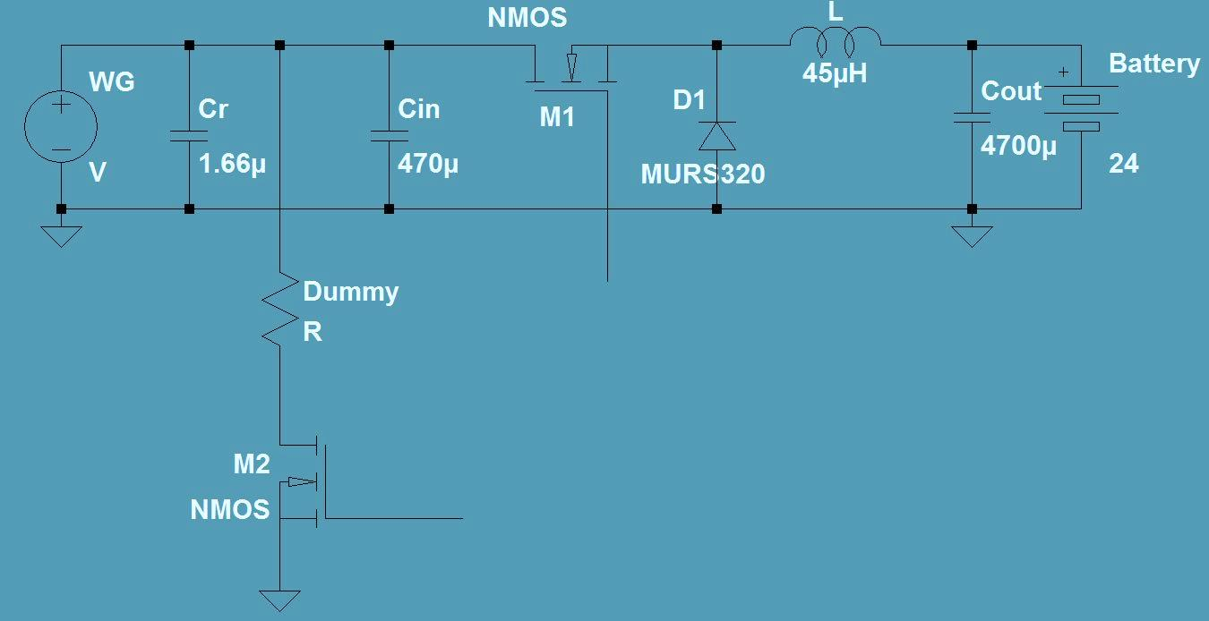
Charge Controller Design
MCU
Interface
Circuit

Slide 10
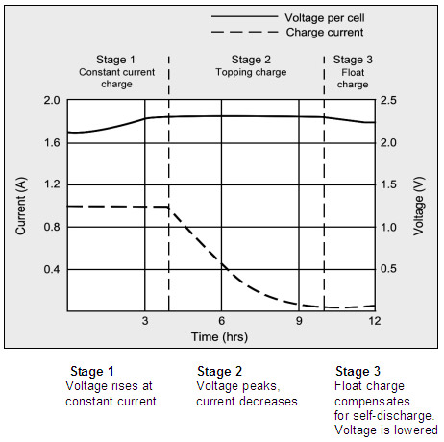

Charge Controller Design
Charging Stages
  Bulk charging stage
  Absorption stage
    $t=0.42\frac{C}{I}$
  Float stage

Slide 11
Maximum Power Point Tracking
Method
  Constant current method
Advantages
  No knowledge of the wind turbine characteristics
  No measurement of wind needed

Slide 12
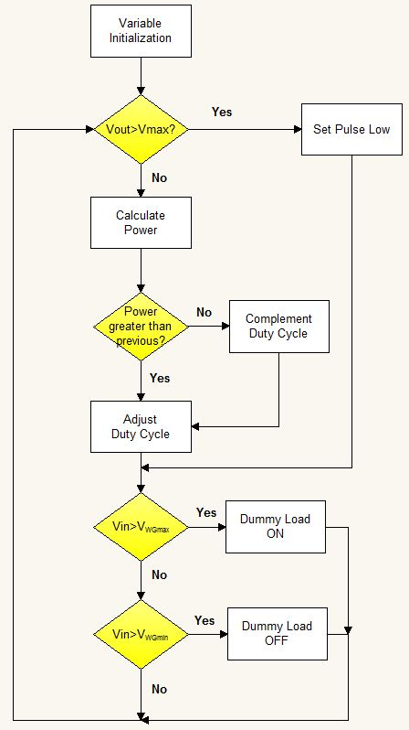
MPPT Flowchart

Slide 13
MPPT Microcontroller
Two ATmega328P
  MPPT algorithm
  MOSFET drivers
  PWM duty cycle adjustment
  Interacts with current and voltage sensors
  Also used for data logging and display.

Slide 14
MOSFET Drivers
IR2121
  Control the MOSFET for dummy load switching
IR2104
  Control the PWM duty cycle for the buck converter

Slide 15
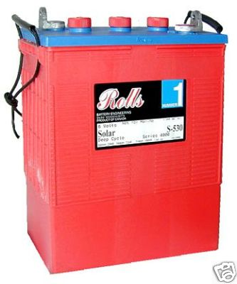
Battery Bank
12 & 24 Volt battery bank
Four 6V Lead Acid Flooded
Length: 12”, Width: 7”, Height: 17”
Weight: 127lbs
400Ah

Slide 16
Positional Control System
Tracking wind direction and speed
Preventing overspinning of turbine rotor
Servomotor

Slide 17
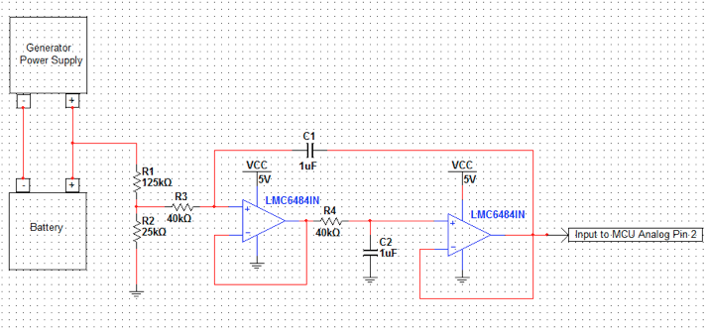
Voltage Sensor
Voltage divider circuit
2nd order Butterworth LPF
Cutoff frequency of 1 Hz and unity gain

Slide 18
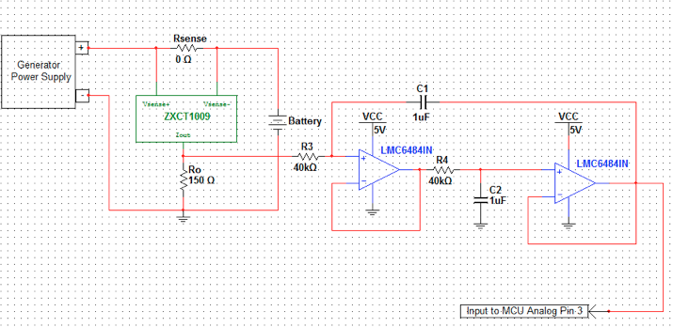
Current Sensor
RMCF1/100R zero ohm resistor
ZXCT1009 high-side current monitor
2nd order Butterworth LPF
Cutoff frequency of 1 Hz, unity gain

Slide 19
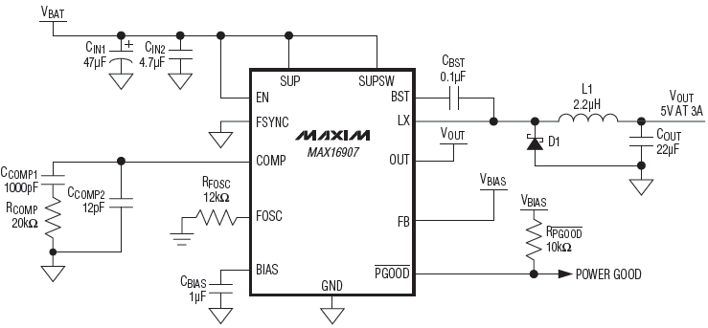
5 Volt Power Supply
Maxim16907 switching regulator
Ideal for high input voltage applications
Over 90% efficiency

Slide 20
Data-logging/Display MCU
Atmega328P
High performance
Low power consumption
32-lead TQFP
20 MHz at 4.5 – 5.5V

Slide 21
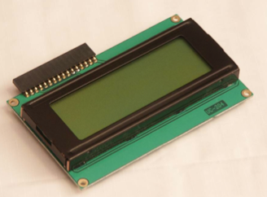
LCD Display
Hitachi HD44780
Four lines 20 characters wide
Low power consumption
Two main interface modes
  Four bits of data sent at a time
  Eight bits of data sent at a time.

Slide 22
LCD Display (cont.)
void lcd_set_type_data()
void lcd_set_type_command()
void lcd_write_nibble(char c)
void lcd_write_byte(char c)
void lcd_write_data(char c)
void lcd_clear_and_home()

Slide 23
PCB Design Software
Altium Designer 10
  Schematic capture
  PCB layout
  3D PCB
  FPGA development
  Embedded software
  Simulation
  CAM

Slide 24
Data Logging Subsystem
Analog Sensor Signal
Digitized Sensor Signal
Serial Data Variable
Plain text format
File on SD Card
Excel or equivalent
ADC
µC
Software
User
Software
Analog Inputs: Current & Voltage Sensors, RTC
Digital Inputs: Wind Speed Sensor, SD

Slide 25
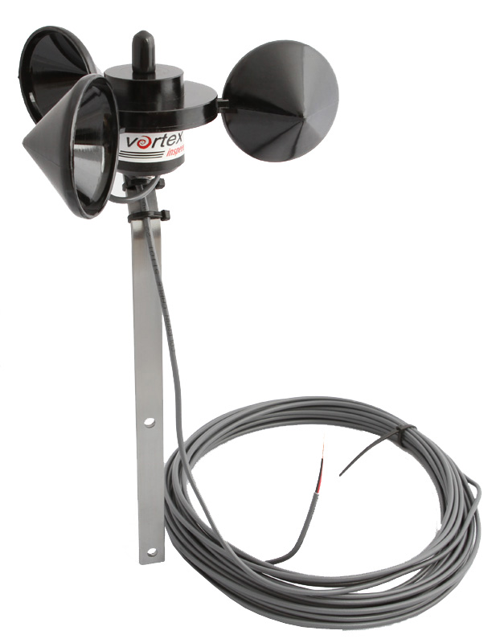
Wind Speed Sensor
InSpeed Vortex
  3-cup rotor
  Mounting bracket
  One pulse per rotation
  2.5 mph / Hz
  6” x 6” x 10”
  1.5 lbs

Slide 26
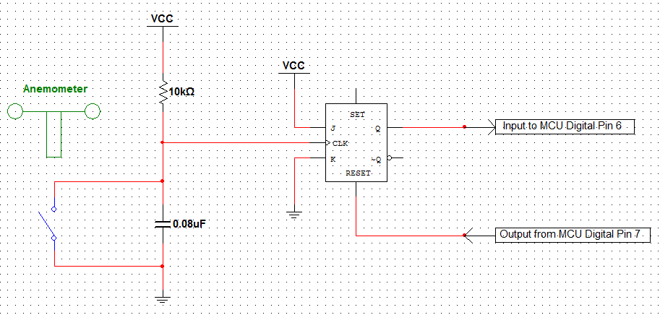
Wind Sensor Interface
Capacitor for de-bounce
Q defaults to high at each falling clock edge
µC resets flip-flop after each pulse

Slide 27
Data Logging Design
The second Atmel µC will be utilized
  Arduino bootloader
Begins logging only when SD is inserted
Will log these data in order:
  The present date (MM/DD/YY)
  The present time (HH:MM:SS)
  Wind speed (mph)
  Current from generator (A)
  Voltage in battery (V)
  Delimited by commas

Slide 28
Data Logging Peripherals
SD/MMC Socket
  Will utilize the open-source SD library
  Formatted for FAT32
  Safe Voltage Level: 3.3 V
LT1761ES5-3.3
  Low-Dropout Linear Regulator
  5 V supply voltage to 3.3 V
  Used to prevent damage to the SD

Slide 29
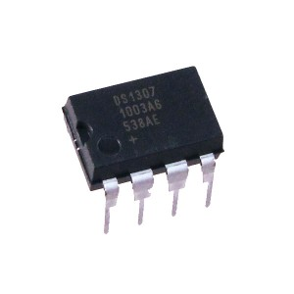

Data Logging Peripherals
DS1307 Real-time Clock
  $I^{2}$C interface to µC
  BCD Calendar & Clock
  Internal backup battery
  Accounts for leap years
Must be interfaced with the Atmel via the correct software libraries

Slide 30
Data Logging Routine
Interrupt-based
Interrupt subroutine runs at 5-second intervals
  Takes readings of current and voltage
  Accumulates over a 1-minute period
Wind speed pulses also counted
Variable Name | Variable Type | Description
chipSelect | int | Hardware chip select for SD card reader
windSpeedIn | int | Hardware pin that reads from wind speed sensor
windSpeedOut | int | Pin that resets JK flip-flop on wind speed sensor
currentSignal | int | Pin that reads from current sensor
voltageSignal | int | Pin that reads from voltage sensor
gLedIn | int | Green LED pin
rLedIn | int | Red LED pin
logTimer | int | Counter until data logging interval
logInterval | int | User-specified data logging interval
pulseCount | int | Counts pulses from wind speed sensor for a minute
checkPin | int | Poll windSpeedIn to check if can clear flip-flop
iSum | longint | Running sum of raw amperage signal readings from ADC3
vSum | longint | Running sum of raw voltage signal readings from ADC2
gLEDStatus | boolean | Green LED on or off
rLEDStatus | boolean | Red LED on or off
dataString | string | Forms plain text output to file on SD
dateTime | string | Time stamp value from RTC chip
windSpeed | float | Sensor constant * (pulseCount / minute )
iAvg | float | Calculated average of current signal readings over a minute
vAvg | float | Calculated average of voltage signal readings over a minute

Slide 31
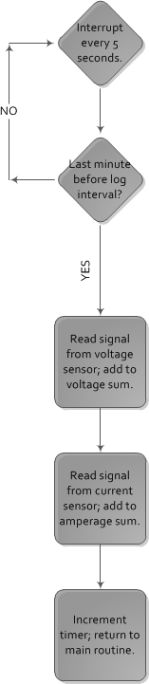
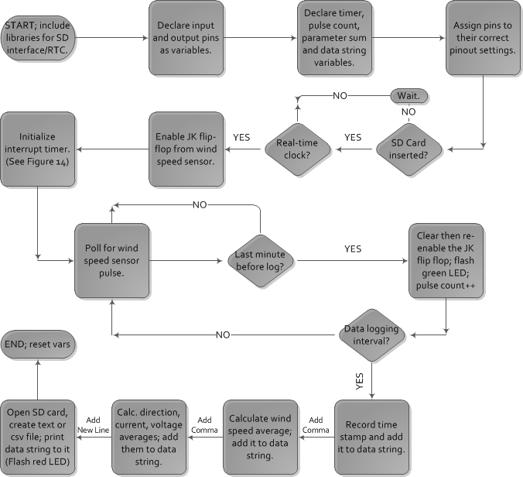
Data Logging Routine

Slide 32
Work Distribution
Dwayne
Wind Turbine
Charge Controller
Joaquim
Battery Bank
Charge Controller
Jose
Tim
MPPT
Sensors
Data Logging
Microcontroller Peripherals
PCB Design
Display
Sensors
Regulators

Slide 33
Progress

Slide 34
Bill of Materials
Part | Quantity | Cost
TLG 500 | 1 | $1575
Batteries | 4 | $1400
PCB | 2 | $100
ATmega328P | 2 | $5
Display | 1 | $3
Regulators | 2 | $10
Wires/Connectors | - | $80
MOSFETs/Drivers | 7 | $7
V/I Sensors | 2 | $3
Wind Speed Sensor | 1 | $55
Miscellaneous | - | $150
Total | - | $3388
Initial Budget | - | $4000

Slide 35
Milestones
Objectives | Date
Parts Acquisition | 6/15
Assembly | 6/20
Order PCB | 6/20
Testing | 6/27

Slide 36
Complications
High power requirements
Difficulty of real world testing
Heat dissipation

Slide 37
Questions?

